Slide 1
Introduction to Web Development
A brief introduction into the world of Web Development

Slide 2
Introduction
Web development refers to the creating, building, and maintaining of websites. It includes aspects such as web design, web publishing, web programming, and database management. It is the creation of an application that works over the internet i.e. websites.
The word Web Development is made up of two words, that is:
Web: It refers to websites, web pages or anything that works over the internet.
Development: It refers to building the application from scratch.

Slide 3
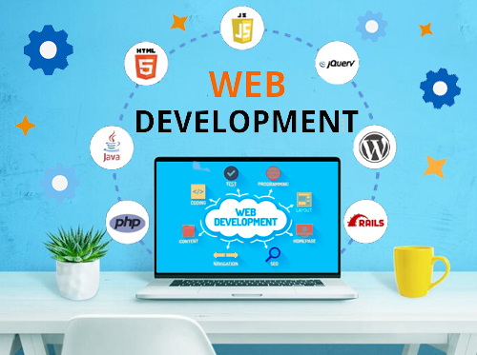

Slide 4
Web Development can be classified into two ways:
Frontend Development
Backend Development
Frontend Development:
Key Technologies and languages:
HTML
HTML is the standard markup language for creating Web pages.
HTML stands for Hyper Text Markup Language
HTML is the standard markup language for creating Web pages
HTML describes the structure of a Web page
HTML consists of a series of elements
HTML elements tell the browser how to display the content
HTML elements label pieces of content such as "this is a heading", "this is a paragraph", "this is a link", etc.

Slide 5
Key Features of HTML:
HTML is an acronym which stands for Hyper Text Markup Language which is used for creating web pages and web applications. Let's see what is meant by Hypertext Markup Language, and Web page.
Hyper Text: Hyper Text simply means "Text within Text." A text has a link within it, is a hypertext. Whenever you click on a link which brings you to a new webpage, you have clicked on a hypertext. Hyper Text is a way to link two or more web pages (HTML documents) with each other.
Markup language: A markup language is a computer language that is used to apply layout and formatting conventions to a text document. Markup language makes text more interactive and dynamic. It can turn text into images, tables, links, etc.
Web Page: A web page is a document which is commonly written in HTML and translated by a web browser. A web page can be identified by entering an URL. A Web page can be of the static or dynamic type. With the help of HTML only, we can create static web pages.
Hence, HTML is a markup language which is used for creating attractive web pages with the help of styling, and which looks in a nice format on a web browser. An HTML document is made of many HTML tags and each HTML tag contains different content.

Slide 6
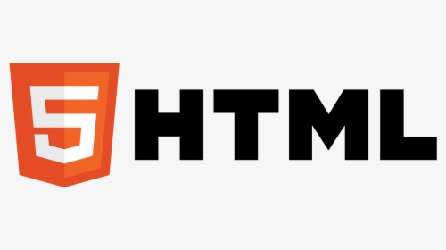
Let's see a simple example of HTML
<!DOCTYPE>
<html>
<head>
<title>Web page title</title>
</head>
<body>
<h1>Write Your First Heading</h1>
<p>Write Your First Paragraph.</p>
</body>
</html>

Slide 7
CSS(Cascading Style Sheets)
Cascading Style Sheets (CSS) is a style sheet language used for describing the presentation of a document written in a markup language such as HTML or XML (including XML dialects such as SVG, MathML or XHTML).[1] CSS is a cornerstone technology of the World Wide Web, alongside HTML and JavaScript.[2]
CSS is designed to enable the separation of content and presentation, including layout, colors, and fonts.[3] This separation can improve content accessibility; provide more flexibility and control in the specification of presentation characteristics; enable multiple web pages to share formatting by specifying the relevant CSS in a separate .css file, which reduces complexity and repetition in the structural content; and enable the .css file to be cached to improve the page load speed between the pages that share the file and its formatting.

Slide 8
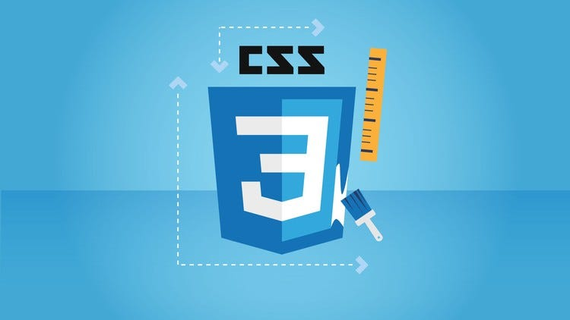
The name cascading comes from the specified priority scheme to determine which style rule applies if more than one rule matches a particular element. This cascading priority scheme is predictable.
In addition to HTML, other markup languages support the use of CSS including XHTML, plain XML, SVG, and XUL. CSS is also used in the GTK widget toolkit.

Slide 9
Syntax:
CSS has a simple syntax and uses a number of English keywords to specify the names of various style properties.
Style sheet
Main article: Style sheet (web development)
A style sheet consists of a list of rules. Each rule or rule-set consists of one or more selectors, and a declaration block.
Selector
"CSS class" redirects here. For non-CSS use of element classes in HTML, see class attribute (HTML).
In CSS, selectors declare which part of the markup a style applies to by matching tags and attributes in the markup itself

Slide 10
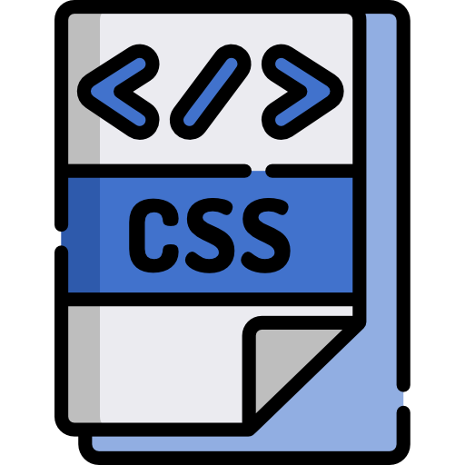
Selectors may apply to the following:
all elements of a specific type, e.g. the second-level headers h2
elements specified by attribute, in particular:
id: an identifier unique within the document, denoted in the selector language by a hash prefix e.g. #id

Slide 11
class: an identifier that can annotate multiple elements in a document, denoted by a dot prefix e.g. .classname (the phrase "CSS class", although sometimes used, is a misnomer, as element classes—specified with the HTML class attribute—is a markup feature that is distinct from browsers' CSS subsystem and the related W3C/WHATWG standards work on document styles; see RDF and microformats for the origins of the "class" system of the Web content model)
elements depending on how they are placed relative to others in the document tree.
Classes and IDs are case-sensitive, start with letters, and can include alphanumeric characters, hyphens, and underscores. A class may apply to any number of instances of any element. An ID may only be applied to a single element

Slide 12
JavaScript
JavaScript (JS) is a lightweight interpreted (or just-in-time compiled) programming language with first-class functions. While it is most well-known as the scripting language for Web pages, many non-browser environments also use it, such as Node.js, Apache CouchDB and Adobe Acrobat. JavaScript is a prototype-based, multi-paradigm, single-threaded, dynamic language, supporting object-oriented, imperative, and declarative (e.g. functional programming) styles.
This section is dedicated to the JavaScript language itself, and not the parts that are specific to Web pages or other host environments. For information about APIs that are specific to Web pages, please see Web APIs and DOM.

Slide 13
Features of Javascript
Scripting Language
JavaScript is a lightweight scripting language made for client-side execution on the browser. Since it is not designed as a general-purpose language and is specially engineered for web applications, the set of libraries is also geared primarily towards web applications.
Interpreter Based
JavaScript is an interpreted language instead of a compiled one. In that sense, it is closer to languages like Ruby and Python. The browser interprets JavaScript’s source code, line by line and runs it. In contrast, a compiled language needs to be compiled into a byte-code code executable. Java and C++ are examples of compiled languages.

Slide 14
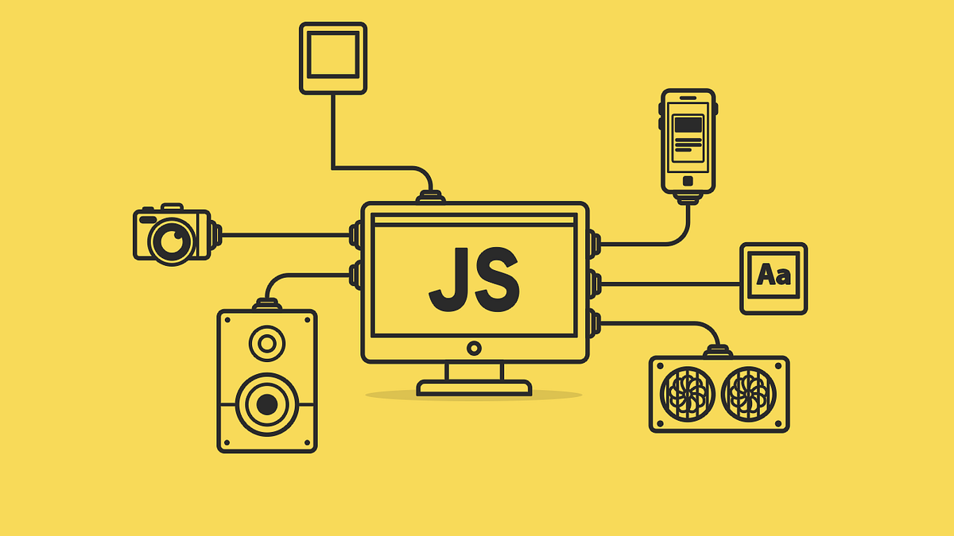

Slide 15
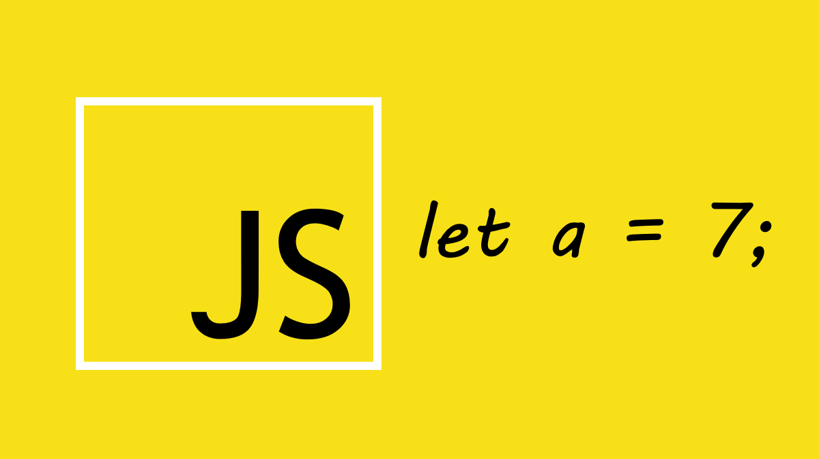
Event Handling
An event is an action or an occurrence in a system that communicates about said occurrence so that you can respond to it somehow. For example, a user clicks on a button, and the system tells you to respond to the button click event with an action, say an information box.
JavaScript enables you to handle events and even generate custom events.

Slide 16
Light Weight
JavaScript isn’t a compiled language, so it doesn’t get converted to byte-code beforehand. However, it does follow a paradigm called Just-In-Time (JIT) Compilation. Meaning it gets converted to bytecode just as it’s about to run. This enables JS to be lightweight. Even less powerful devices are capable of running JavaScript.
Case Sensitive
JavaScript is highly case sensitive. All keywords, variables, functions names and other identifiers can and must only follow a consistent capitalisation of letters. E.g.:
var hitCounter = 5
var hitcounter = 5
Here variables hitCounter and hitcounter are both different variables because of the difference in the case. Also, all keywords such as “var” are case sensitive.

Slide 17
Control Statements
JavaScript is equipped with control statements like if-else-if, switch-case, and loops like for, while, and do-while loops. These control statements make it a powerful programming language, enabling its user to write complex logic.
Objects as first-class citizens
All non-primitive data types in JavaScript are actually objects, i.e. data types like Arrays, Functions, Symbols etc. inherit all the properties of the Object prototype.
The term first-class citizen means “being able to do what everyone else can do”. In JavaScript Objects prototype is the base prototype of all. They can be passed as reference, returned in a function, and assigned to variables for manipulation. This concept is also extended to functions as Object is also the prototype of functions.

Slide 18
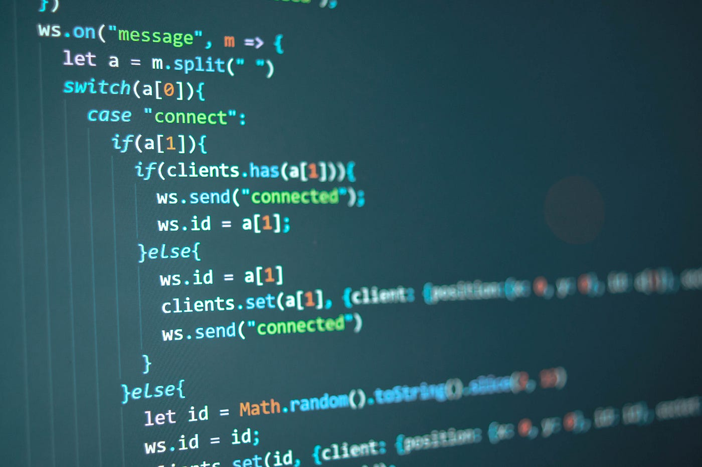
Functions as First-class citizens(supports functional programming)
Functions that return a function are called Higher Order Functions, which JavaScript supports. Functions as first-class citizens simply mean functions enjoy similar behaviour from the JavaScript interpreter as that of objects or any other variable. Meaning, we can pass them into arguments (pass by reference), return them by another function, and assign them to a variable as a value.

Slide 19
Introduction to Backend Technologies
Back-end development refers to the development of server-side operations. These operations can fetch information from data storage sites, script website functions, and ensure seamless communication between browsers and databases.
Some important Backend Development tools:
Python
Ruby on rails
PHP

Slide 20
Python
Python is considered one of the easiest programming languages to learn. While Python can be used to create complex functions and power in-depth web features, the basics of this language are straightforward. Beginners can start building simple programs and scripts very quickly.
Along with Python expertise, back-end developers also need a passion for problem-solving. The nature of web-based services and solutions means that they don’t always work as intended. Back-end Python developers are often tasked with unpacking potential problems to create effective solutions.
In some cases, this is easy. In others, it may require substantial time and effort. As a result, a preference for Python problem-solving is essential.

Slide 21

As Python becomes more popular, new career paths are opening up.
The most popular Python positions are for full-stack developers. These professions are responsible for front-end and back-end development. A complete understanding of python plays an essential part in these roles.

Slide 22
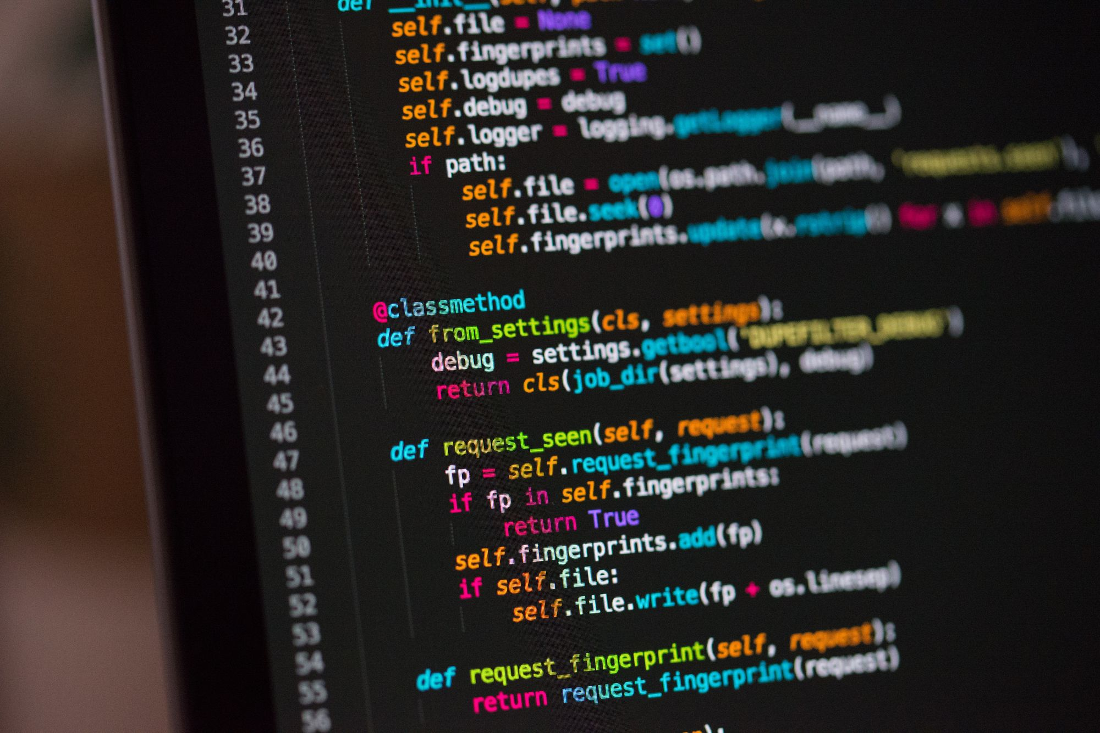
Other common career paths include web developers who have skills in Python along with other languages like C or JavaScript. You can also find administrator roles where developers manage the larger scope of application development and design across an organization.
Python developers may also choose to freelance and work as independent developers or consultants. As a freelancer, a developer can choose to focus exclusively on back-end development.

Slide 23
Ruby
Ruby on Rails (RoR) is a hot and sizzling topic in software development. Web developers worldwide can barely converse without bringing the Ruby on Rails framework at least once. No wonder, the fact that Ruby on Rails is named among the top 10 most utilized frameworks in the United States, all due to its significance in the web development world and its popularity. We can also say that Ruby on Rails popularity adds fuel to the fire (but in a safe way). Nothing to get startled by as Ruby on Rails (RoR) has several unique features and functionalities, making it a robust tool for your next software development project. Or, we must say, for your next Ruby on Rails project.

Slide 24
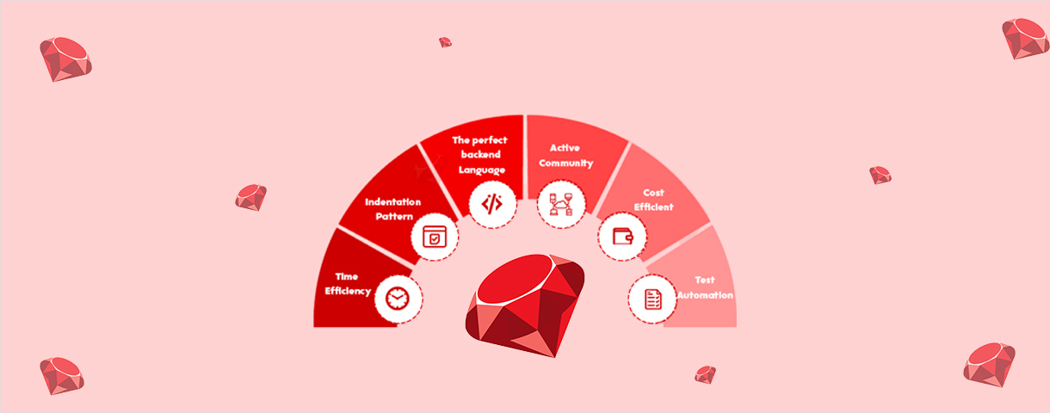

Slide 25
Ruby on Rails or also known as rails is a server-side web application development framework that is written in the Ruby programming language, and it is developed by David Heinemeier Hansson under the MIT License. It supports MVC(model-view-controller) architecture that provides a default structure for database, web pages, and web services, it also uses web standards like JSON or XML for transfer data and HTML, CSS, and JavaScript for the user interface. It emphasizes the use of other well-known software engineering pattern and paradigms like:
Don’t Repeat Yourself (DRY): It is a principle of software development to reducing the repetition of information or codes.
Convention Over Configuration (CoC): It provides many opinions for the best way to do many things in a web application.

Slide 26

Advantages of Ruby on Rails:
It allows you to launch a faster web application.
Saves your money by using the Ruby on Rails framework.
Helps us with maintaining and avoiding problems with stuff migration.

Slide 27
Ruby on Rail Framework makes our app faster and safer.
We can easily update our app with the latest functionality.
It uses Metaprogramming techniques to write programs.

Slide 28
PHP
PHP is a common open-source scripting language popular for web applications. Although it originally stood for “personal home page,” PHP is now a recursive acronym for “hypertext preprocessor,” — though chances are you’ll never hear that name again.
PHP is a server-side scripting language embedded in HTML in its simplest form. PHP allows web developers to create dynamic content and interact with databases. PHP is known for its simplicity, speed, and flexibility — features that have made it a cornerstone in the web development world.

Slide 29
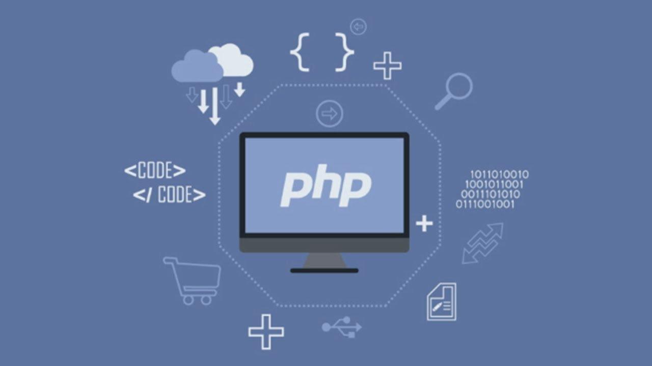

Slide 30
PHP: A Primer
Like any other scripting language, PHP is fundamentally the tool you use to connect to your database to get information and hand that information over to your web server to be displayed in HTML. But many aspects of PHP set it apart from other languages. PHP is
A Scripting Language: Scripting languages are interpreted by another program at runtime (no need for compilation). Scripting languages can be interpreted server-side or client-side (in the browser).
Server-Side: PHP is a server-side scripting language processed by a PHP interpreter on a web server; the result (the output) is sent to the web browser as plain HTML.
Open-Source: PHP is freely available to download and use.

Slide 31
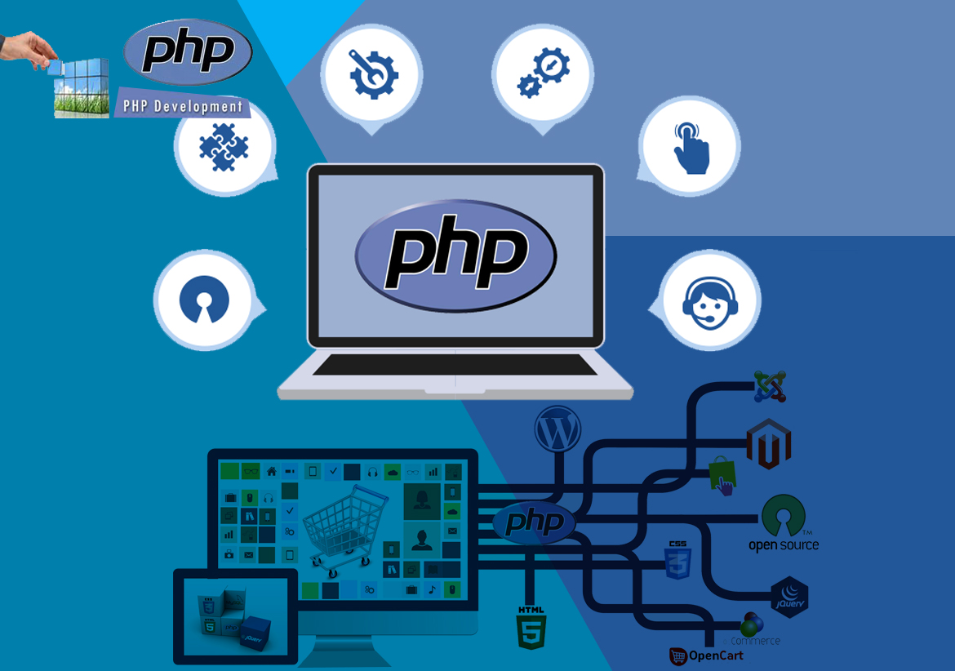
Well Supported: PHP supports all leading databases (MySQL, SQLite, ODBC) and is compatible with most servers (Apache, IIS, etc.). It is portable across all platforms (Windows, Mac OS, Linux, etc., and can be further supported by PHP frameworks (Laravel, CodeIgniter, Symfony) and many well-stocked and vetted libraries

Slide 32
Object-Oriented: Object-Oriented Programming (OOP) leverages the concept of “objects” to contain data and functions to help build more complex, reusable web applications. OOP was added to PHP5.
Fast: PHP uses its memory, minimizing server workload and increasing performance. PHP can be up to 382% faster than Python and 195% faster than Ruby.
Simple: The PHP syntax is easily understood and learned, whether you’re building from scratch or leveraging existing frameworks or add-ons.

